Slide 1
Skill-Synergy
GROUP-A2
Hasin Eshrak (2030486)
Rizwan Mohammad Chowdhury (2121028)
Farhat Lamisa (1910539)
Md. Arifinul Hoque Chowdhury Arian (2031015)
Md. Mahabub Alam Mahin (2030526)
Sayed Mohammad Nayem (1911247)

Slide 2
Introduction
Our project focuses on ensuring everyone has access to quality education.
We propose a web platform (E-learning website) utilizing cloud technology.
The platform offers courses, educational materials, and virtual classrooms.
It enables students from any background to access top-notch education.
Students can learn at their convenience and from any location.
Cloud technology ensures access to educational content regardless of location or device.
Engaging learning modules cover a range of subjects to suit preferences.
Real-time collaboration between students and teachers fosters a learning environment.
Educators benefit from analytics to track student progress and personalize teaching methods.
The web platform contributes to achieving Sustainable Development Goals (SDGs).
Quality resources provided to underserved communities bridge the education gap.
Empowers individuals to realize their full potential for a fairer, more prosperous society.

Slide 3
Methodologies
The project will use an iterative development methodology blending Waterfall and Agile processes.
Initial phases will focus on comprehensive requirements collection, including PLOs and CLOs creation.
Top priority will be given to creating PLOs at the program level and incorporating CLOs into specific courses in upcoming development cycles.
Stakeholder meetings and feedback sessions will be crucial throughout the development lifecycle for refining the application of learning outcomes.

Slide 4
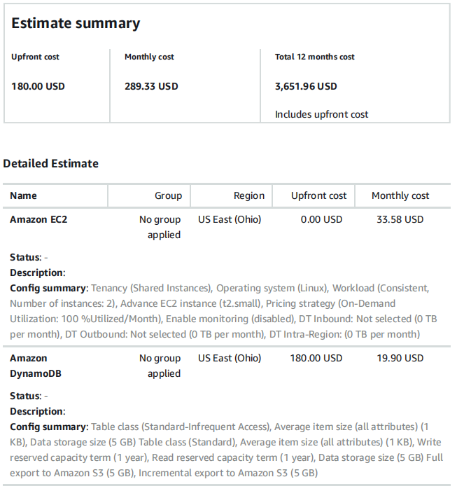
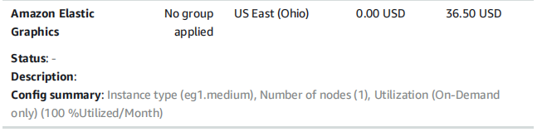
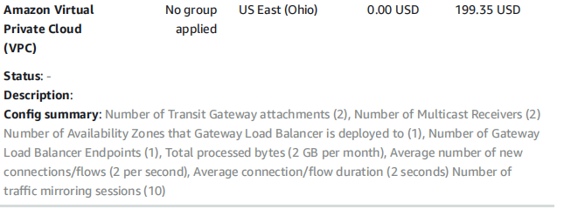
Cost Analysis

Slide 5
Real-World Applications
Skill Synergy e-learning platform aims to bridge global education gaps.
Provides universal access to quality education.
Tailored for underserved communities.
Offers diverse courses and resources.
Empowers individuals regardless of location or socioeconomic status.
Flexible learning options cater to diverse needs.
Benefits professionals, caregivers, and those with limited mobility.
Real-time collaboration fosters dynamic learning environments.
Aligned with the Sustainable Development Goal for Quality Education.
Contributes to a more equitable society and global sustainable development.

Slide 6
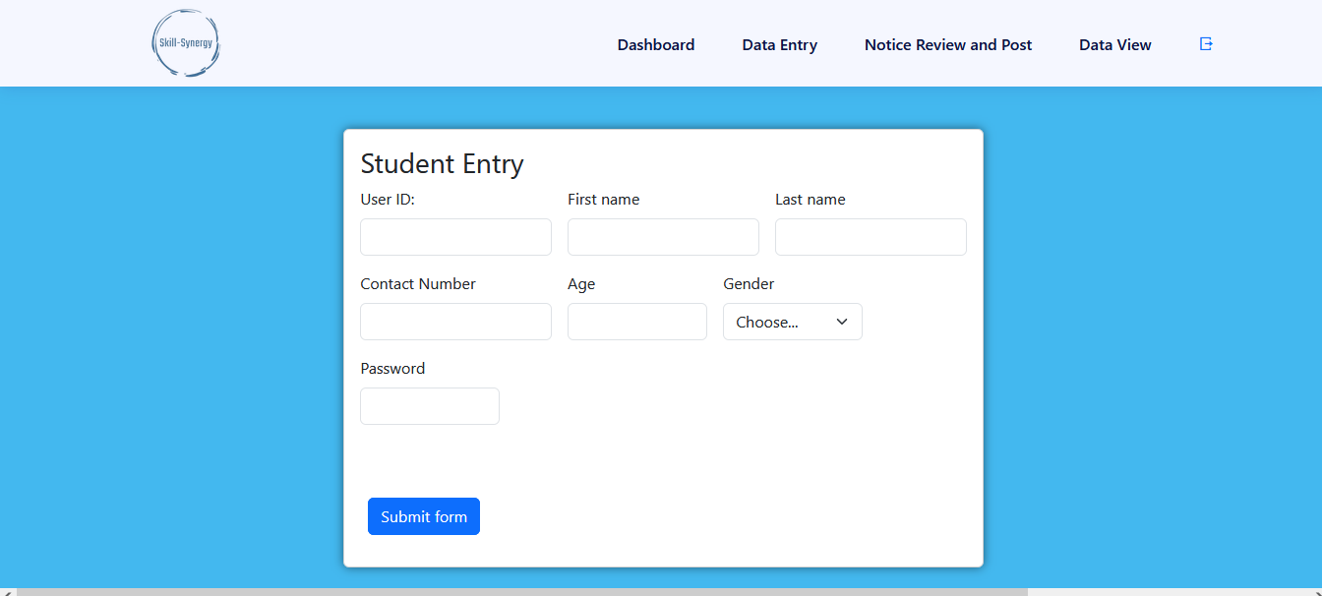
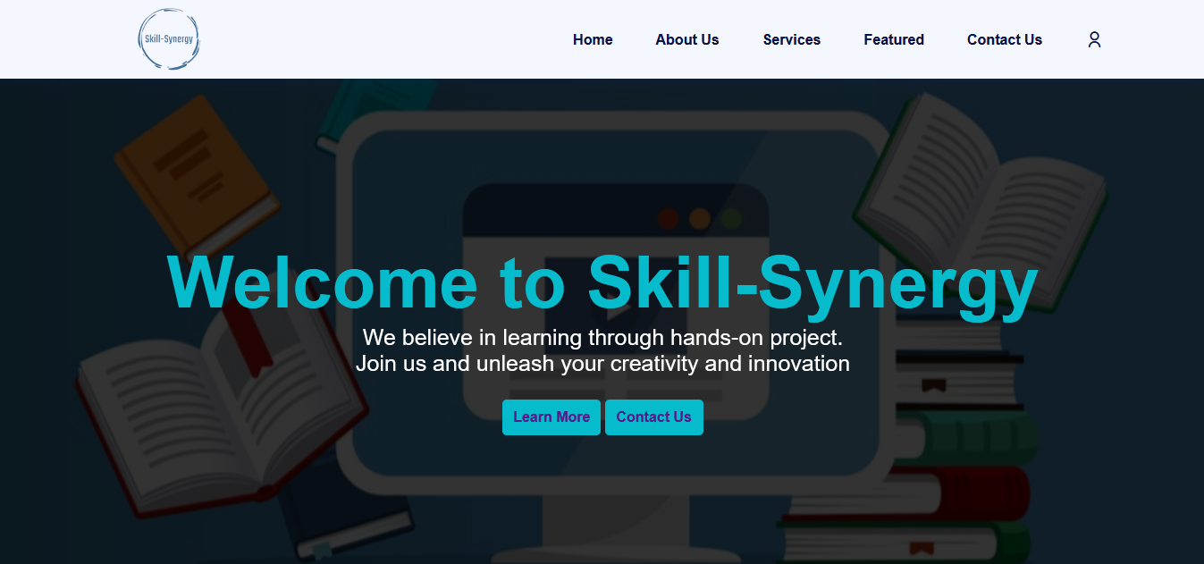
The Website

Slide 7
Conclusion
The hybrid e-learning platform presents a promising solution to address global education disparities. By leveraging cloud technology and adopting an iterative development methodology, the platform ensures universal access to quality education while promoting real-time collaboration and personalized learning experiences. Further research and implementation efforts are warranted to fully realize the platform’s potential impact on achieving equitable education worldwide.

Slide 8
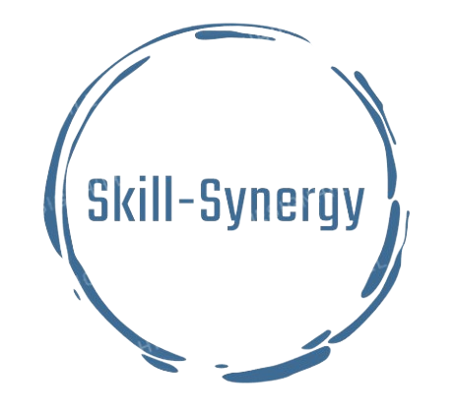
THANK YOU!!

